Slide 1
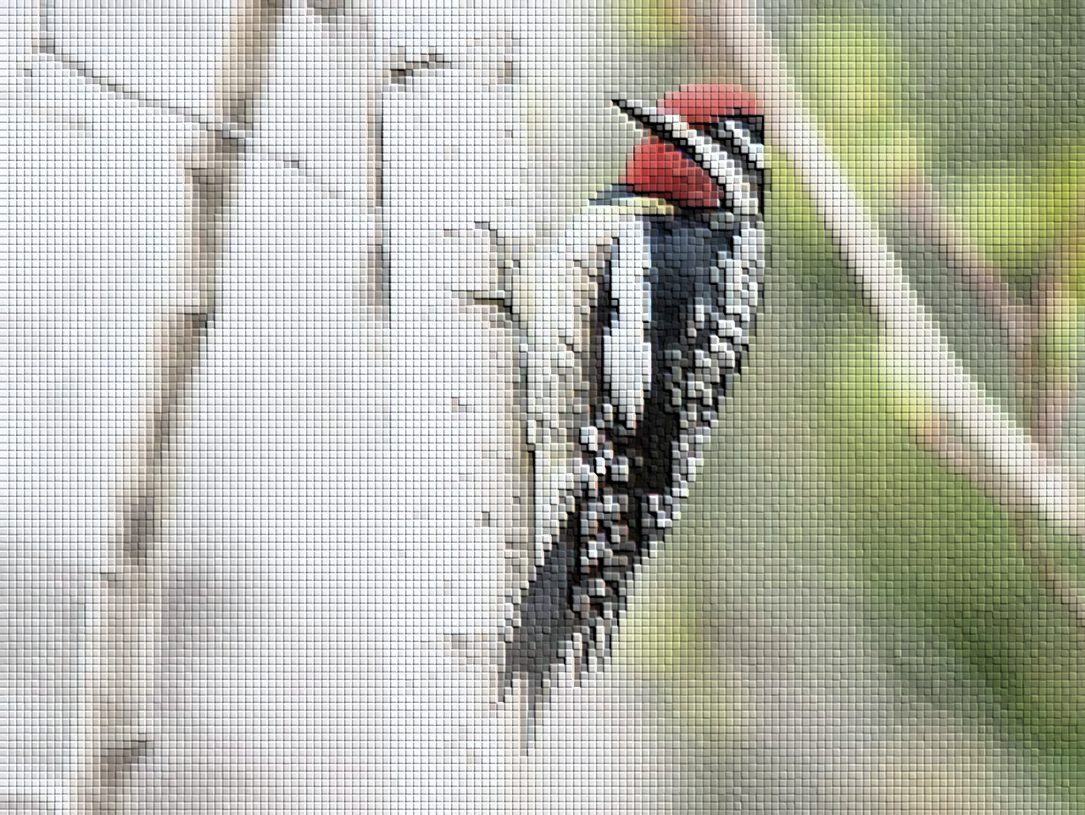
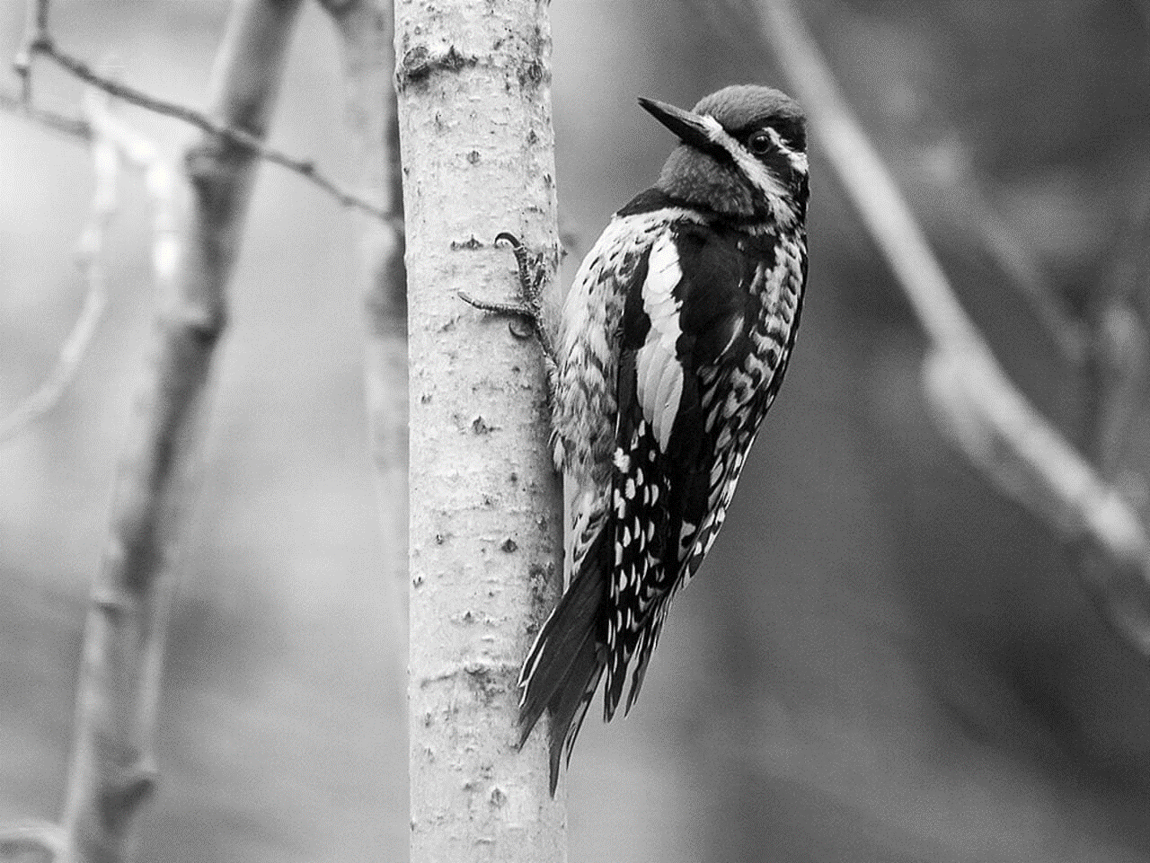

Analyzing bird populations through space and time
David Iles david.iles@ec.gc.ca

Slide 2
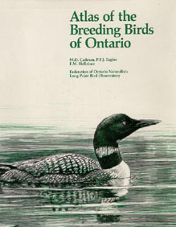
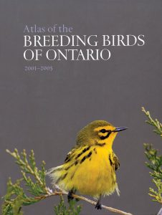
Breeding Bird Atlases
Engaging the public
Appreciation and stewardship of birds and their habitats
Supporting research and education
New insights into bird ecology
Mapping bird distributions
Discover habitat associations and biodiversity hotspots
Assessing population status and trend
Monitor the health of populations
Informing conservation and management
Designate protected areas, inform land acquisition

Slide 3
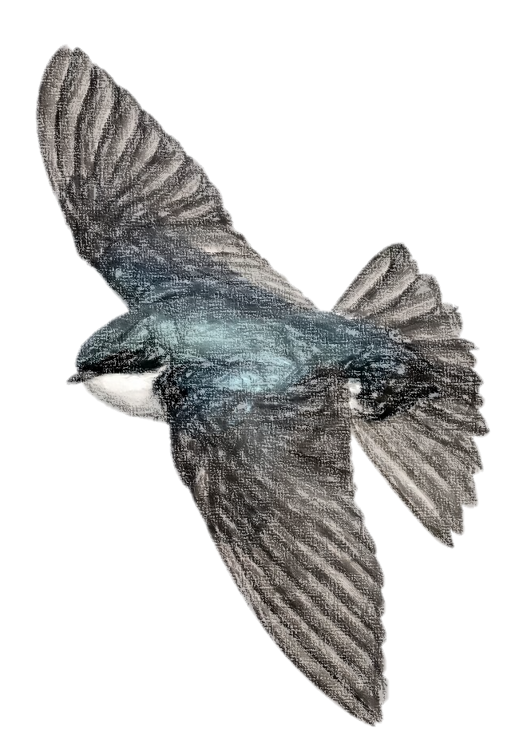
Breeding Bird Atlases
Distribute effort across the province
Involvement of volunteers and professionals
Illustrate effort in atlas vs non-atlas years:
Ontario, Saskatchewan, BC, Maritimes

Slide 4
Types of data
Checklists
Point counts
Recordings
General atlassing (checklists)
Presence / absence
Relative abundance

Slide 5
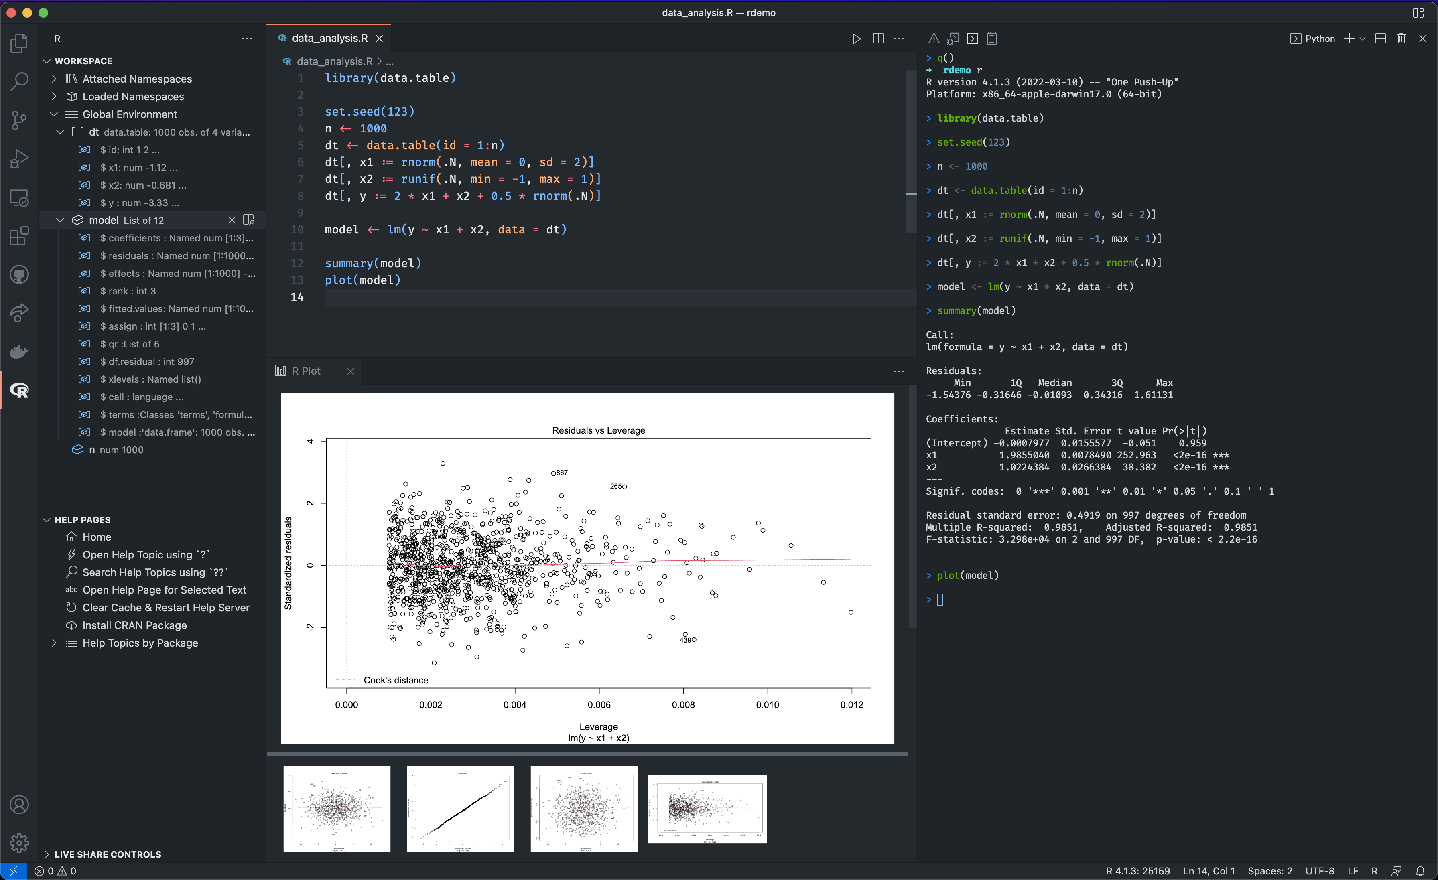
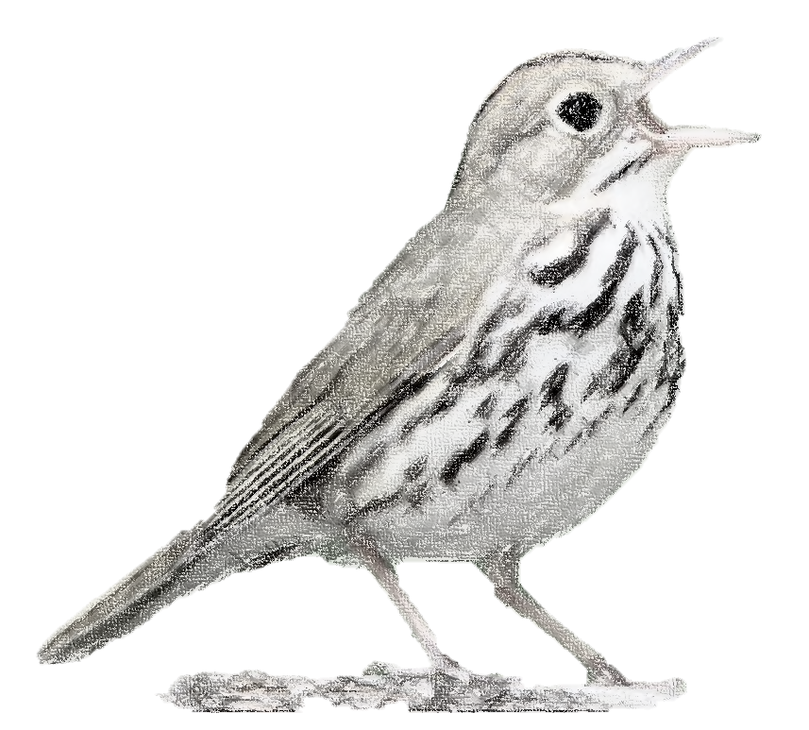
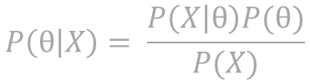
Analysis
“Statistics is the grammar of science”
-Karl Pearson
$$P\left(θ | X\right)= \frac{P\left(X | θ\right)P(θ)}{P(X)}$$

Slide 6
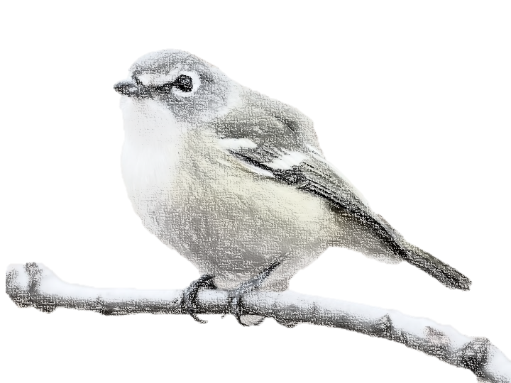
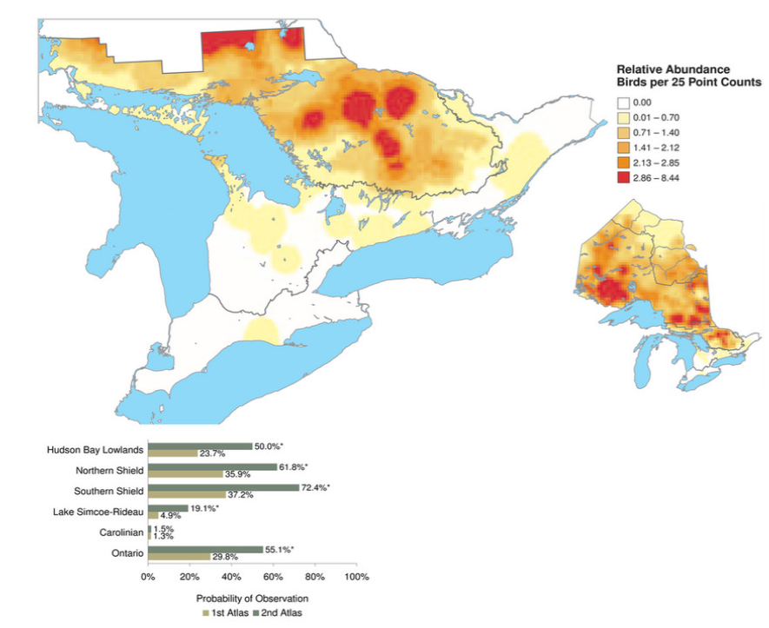
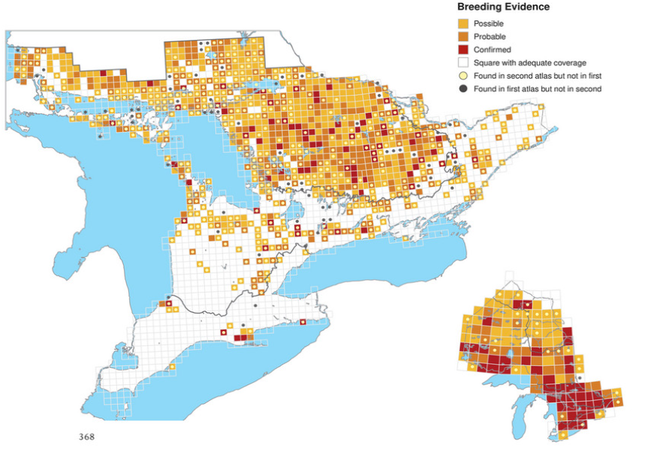
Bird Distributions

Slide 7
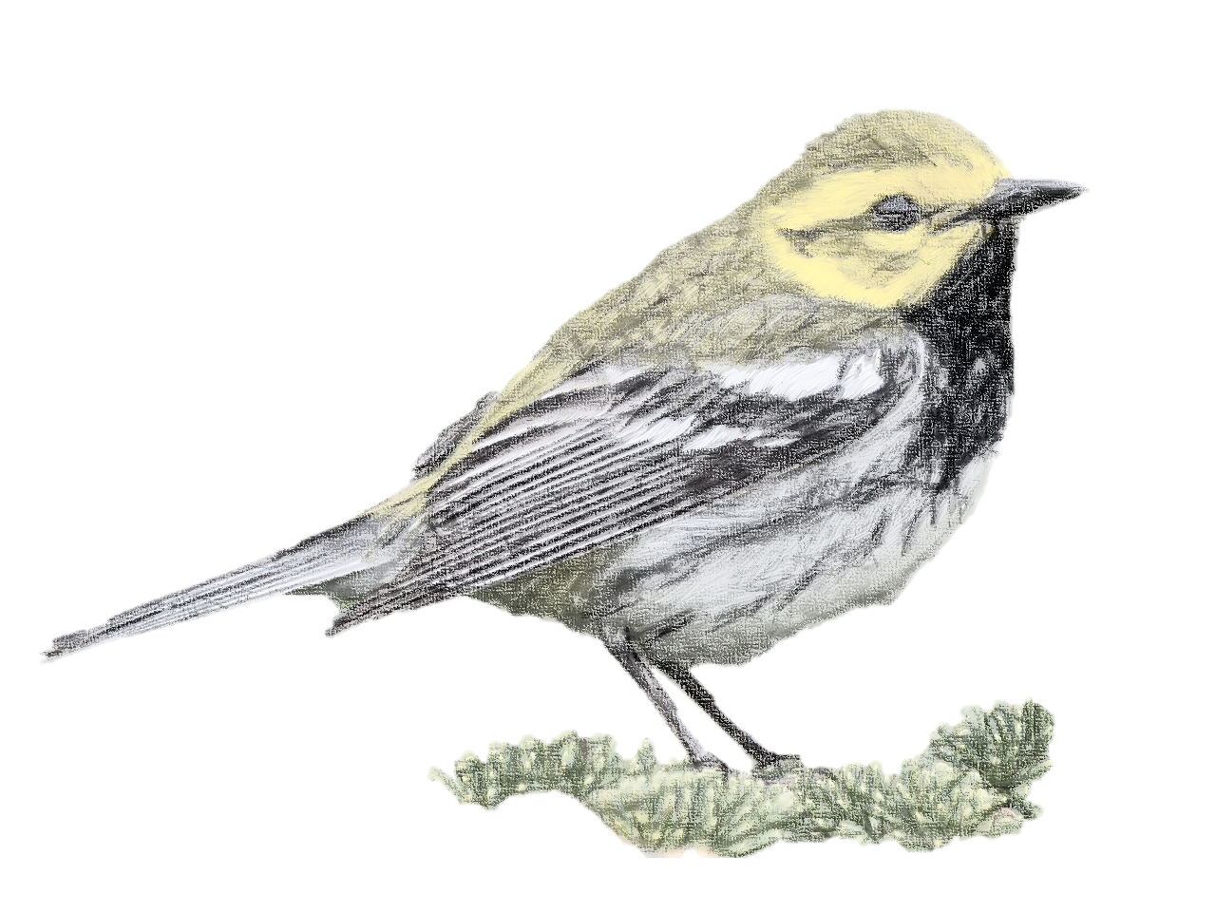
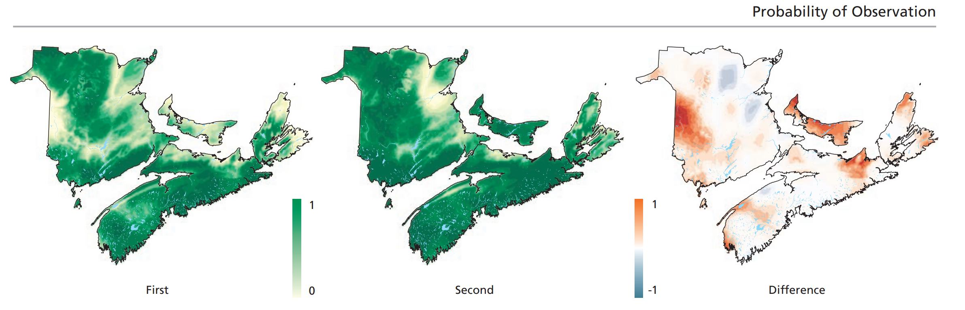
Population Change

Slide 8
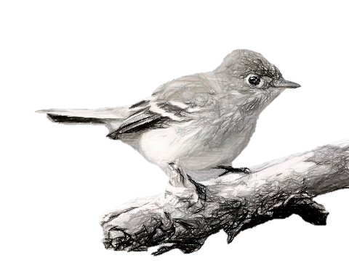
Conservation
Examples of conservation
Species at risk

Slide 9
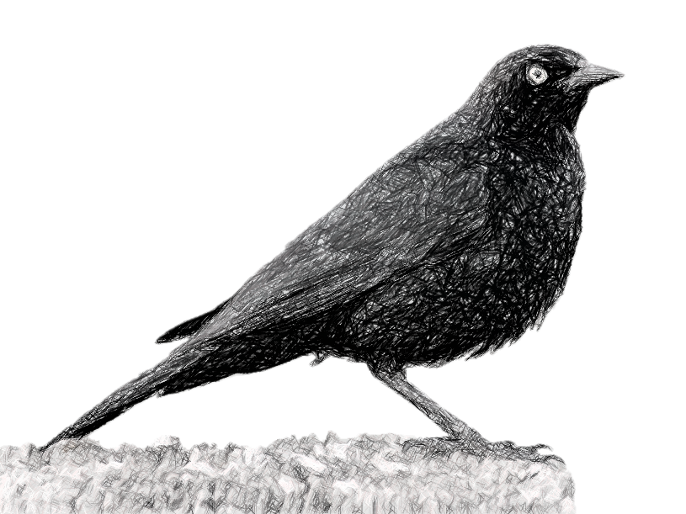
Acknowledgments

